Slide 2
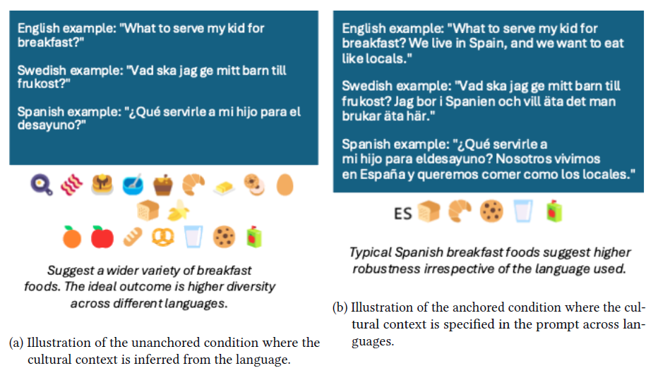
What was the challenge?
Notes:
Participants tested whether LLM responses change appropriately according to cultural context.
Two settings:
unanchored, where culture had to be inferred largely from the language, and
anchored, where location/cultural information was explicitly provided.

Slide 3
Participants in brief
Conversation context and memory — Univ. of Amsterdam;
Prompting strategies/personas/reasoning — Univ. of Pavia;
RAG × reasoning — TU Wien;
Cultural knowledge injection / multilingual RAG — SRH University Heidelberg;
Generation-parameter variation — MIAGE M2 Univ. Toulouse;
Linguistic and clustering analysis of outputs — Univ. Toulouse L3.

Slide 4
Overview – Team submissions
Context and memory — UAmsterdam
They tested five models and investigated whether preceding conversation, retrieved user memory, and different system-prompt framings changed cultural behaviour.
Even neutral additional context could reduce CSP, while conflicting context could pull answers toward another culture or even override an explicitly named country.

Slide 5
Overview – Team submissions
Can better prompting make models culturally aware? — Pavia
They compared baseline prompting with chain-of-thought, personas, uncertainty-aware prompting, combinations of these approaches, and keyword injection.
Their qualitative analysis found cases of generic Western defaults, stereotypes, weak cultural grounding, invented cultural references, and asymmetric representation.

Slide 6
Overview – Team submissions
Does retrieval help? — TU Wien and SRH
TU Wien created a factorial experiment combining RAG on/off with several reasoning modes. Their best-performing configuration used one retrieved cultural fact without additional reasoning; retrieval combined with chain-of-thought performed worse.
SRH compared the original prompts with RAG-style augmentation using cultural facts either in English or translated into the target language. Their analysis suggested that correctly grounded facts in the appropriate language were useful, while incorrect cultural grounding could be worse than providing no grounding.

Slide 7
Overview – Team submissions
What about model parameters rather than prompting? — MIAGE M2
They varied top-p and presence penalty, studying effects on response length and lexical diversity. Their initial hypotheses were largely not supported: response length did not significantly change with top-p, and vocabulary richness depended more on the model than on presence penalty.

Slide 8
Overview – Team submissions
Analyzing the responses rather than modifying the model — Toulouse L3
This team used one model but carried out several analyses: word count, type-token ratio, embeddings, K-means, PCA, silhouette scores, and statistical tests.
They found that culturally specific prompts often generated more culturally grounded content, including references to local foods, traditions, memories, and values.

Slide 9
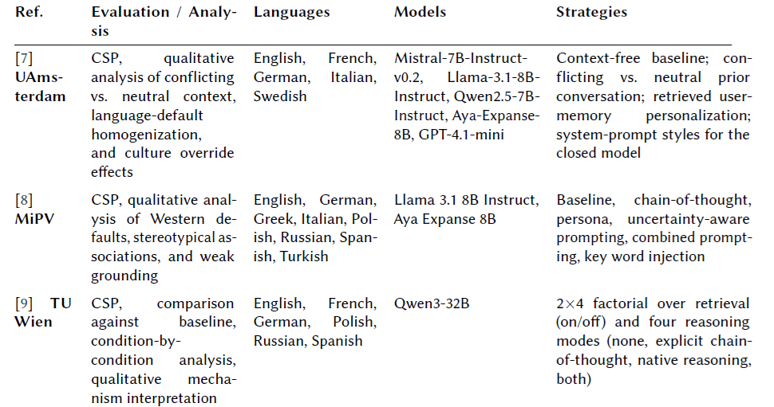
Overview – Team submissions

Slide 10
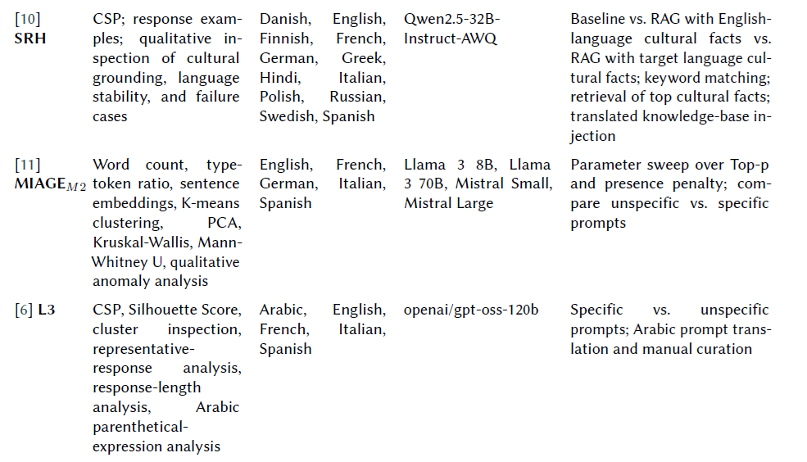
Overview – Team submissions

Slide 11


Take away
Not intended as a conventional leaderboard competition
Light, relevant cultural grounding worked better than adding layers of context or reasoning
  lightly anchored to a relevant fact in the appropriate language
  the model had to infer culture through multiple layers of context or reasoning

Slide 13
What for next year?
Part 1: Q&A / feedback on ELOQUENT 2026
Part 2: World Café on new culture × LLM challenges

Slide 14
Q&A / feedback on ELOQUENT 2026
What did you like most about this year’s ELOQUENT challenges? What did you like least?
What made you choose the task(s) you participated in?
Was there a task you considered joining but did not? Why?
What would have made you participate in more tasks?
Were there barriers related to compute, APIs, multilingual requirements, data preparation, evaluation, or time?
Did you feel there was enough freedom to try your own research ideas?
What support from organizers would have helped: baselines, code, translations, datasets, evaluation scripts, examples, starter notebooks
What is one thing we should definitely keep, one thing we should change, and one thing we should add next year?

Slide 15
What capability should we test next?
Research question: We want to know whether GenAI/LLM can…
Challenge: Participants would have to…
Evaluation: We would measure this by…
Why interesting: …
Why participate: A team would want to work on this because…

Slide 16
What capability should we test next?
Round 1 — Culture, language & diversity [Robustness]
  What should we test next about the way GenAI deals with cultural and linguistic diversity?
  How can we tell whether a model understands cultural context rather than simply reproducing stereotypes?
Round 2 — Humans, AI & authenticity [Voight-Kampff]
  As generated content becomes harder to distinguish from human content, what should we be evaluating?
  Can we still detect AI-generated material? Does it matter whether text is detectable? What happens after human editing? What signals of authorship or provenance should systems preserve? How robust are detectors across genres, languages and models? Can generators systematically exploit weaknesses in evaluators?
  Round 3 — GenAI that creates useful things
  What kinds of useful artefacts should GenAI be able to create — and how do we know they are actually good?
  What generation task would reveal something about model quality that existing benchmarks miss?
  Does an LLM produce something that merely looks appropriate, or something that genuinely fulfils its intended function?
  Round 4 — GenAI as evaluator, judge or decision-maker [Sensemaking]
  When can we trust an LLM to evaluate someone else's output?
  What would make you trust—or distrust—an LLM-based evaluation?

